Slide 1


Nagar Yuvak Shikshan Sanstha’s
Yeshwantrao Chavan College of Engineering
(An Autonomous Institution affiliated to Rashtrasant Tukadoji Maharaj Nagpur University)
(Accredited 'A++' Grade by NAAC)
DEPARTMENT OF COMPUTER SCIENCE & ENGINEERING
Session 2023-24
IOT based manual and automated monitoring and controlling for cold storage system
by
Group no. 17
Harshal Borkar (Roll No: 46)
Sankit Binkar (Roll No: 67)
Aditya Pethe (Roll No: 32)
Soniya Rangari (Roll No: 124)
Guide
Prof. Jiwan N. Dehankar

Slide 2
CONTENTS
Introduction
Abstract
Aims and Objectives
Literature Review + Patent Search
Methodology
Results and Discussions
Conclusion and Future Scope
References

Slide 3
Introduction
Many of the food import and export industries are facing issues for maintaining quality and lifespan of food in food storage. The actual problem received is for storing bananas. The issue is that after power cuts off, there is rapid growth of bacteria's and microorganism due to which bananas get rotten which result in huge loss. They want a system which can help in monitoring of storage environment which can be remotely controlled. The system must be able to release the specific amount of ethylene gas for specific amount of time.
So we are providing a solution by designing a system using microcontroller, different kind of IoT components, sensors and web technology. The system will be able to monitor and analyze environment and it will release ethylene gas. The user can remotely set the time and amount of gas.

Slide 4
Abstract
Food import and export industries face challenges in maintaining the quality and lifespan of bananas due to rapid microbial growth during power outages, leading to significant spoilage. To address this, we propose a microcontroller-based IoT system that monitors the storage environment and remotely controls the release of ethylene gas, ensuring optimal conditions and reducing losses.

Slide 5
Problem Statement
Develop a system to monitor and control the environment of cold storage facilities in order to maintain the quality of stored items and extend their lifespan.

Slide 6
Aims and Objectives
To monitor and control the cold storage environment remotely through web application.
To maintain quality and increase life span of food by controlling the growth of bacteria & micro-organisms.
To develop alert system and automated control for client.
To maximize profit

Slide 7
Literature Review
Sr. No. | Title | Date and Year | Claim by Author | Our Findings
1 | Maged Mohammed, Khaled Riad, Nashi Alqahtani, “Design of a Smart IoT-Based Control System for Remotely Managing Cold Storage Facilities”. Sensors 2022, 22(13), 4680 (2022). | 21 June 2022 | Enhanced Monitoring and Control Fault Detection and Maintenance Scalability and Flexibility Energy Efficiency | Displays the maintenance status in cold chain plants. Collect environmental data such as temperature and humidity. Cloud server module is used to deliver communication data

Slide 8
Literature Review
Sr. No. | Title | Date and Year | Claim by Author | Our Findings
2 | Yanlin T, Zuoxin Hu, Tianyu T, Xin Gao, “Effect of goods stacking mode on temperature field of cold storage”. Proceedings of EEEP 2020 IOP Conference Series: Earth and Environmental Science. Volume 675(1): 012052, 5th ICEEEP, IOP Publishing. Orlando, FL (2021). | February 2021 | Impact of Stacking Mode Temperature Uniformity Energy Efficiency Goods Preservation Simulation and Validation | Adopt WSN based continuous monitoring of temperature and humidity of the cold storage warehouses

Slide 9
Literature Review
Sr. No. | Title | Date and Year | Claim by Author | Our Findings
3 | Hina Afreen, Imran Sarwar Bajwa, “An IoT-Based Real-Time Intelligent Monitoring and Notification System of Cold Storage”. IEEE Access PP(99): 1-1. (Volume 9), ISSN: 2169-3536, (2021). | February 2021 | Real-Time Monitoring Intelligent Notifications Data Analytics Energy Efficiency User Accessibility | Use of API for alert system

Slide 10
Literature Review
Sr. No. | Title | Date and Year | Claim by Author | Our Findings
4 | Santoso Budijono, Felita, “Smart Temperature Monitoring System Using ESP32 and DS18B20”. 4th International Conference on Eco Engineering Development 2020, Banten, Indonesia. IOP Conf. Series: Earth and Environmental Science, Volume: 794 012125 (2021). | 11 November 2020 | Efficient Temperature Monitoring Real-Time Data Wireless Connectivity | To ensure the quality of products across the supply chain, the system can track the location and temperature of those products in real-time.

Slide 11
Patent Search
Patent Application No. | Title of Patent | Existing Solutions
US1515546A | Cold Storage System | Refrigeration or cold storage of perishable food products of various kinds which require the presence of the proper amount of air, the proper relative humidity, and correct uniform temperature, for their preservation
US4989417A | Cold storage warehouse | The cold storage warehouse design features an inner grouping of cells for below-zero temperature storage, surrounded by an outer ring of cells for above-freezing temperature storage. Temperature control is achieved through a system of finned ducts suspended beneath the ceiling, with reversible ceiling fans aiding in air circulation

Slide 12
Methodology
The system uses Master NodeMCU to send data to cloud server. On the web-based Control Panel fields are there which display recorded values of Temperature, Humidity and Gas Sensor. DHT11 Temperature and MQ-3 gas sensor are connected to the Slave controller. These sensors are used to measure and monitor temperature, humidity and gas values present in the cold storage chamber, respectively. Relay 1 is connected to slave ESP controller to turn Air Conditioner ON and OFF. LCD display of 16*2 is used to display temperature and gas values sensed by sensors. Relay 2 is connected to master ESP controller for operation of Ethylene gas cylinder.
Steps:
Study of working of required components.
Individual testing of components.
Integrating IoT hardware components.
Integrating different components code with hardware and testing.
Developing frontend and backend for client.
Integrating software and hardware.
Advancing the system with cloud (Remote access).

Slide 13
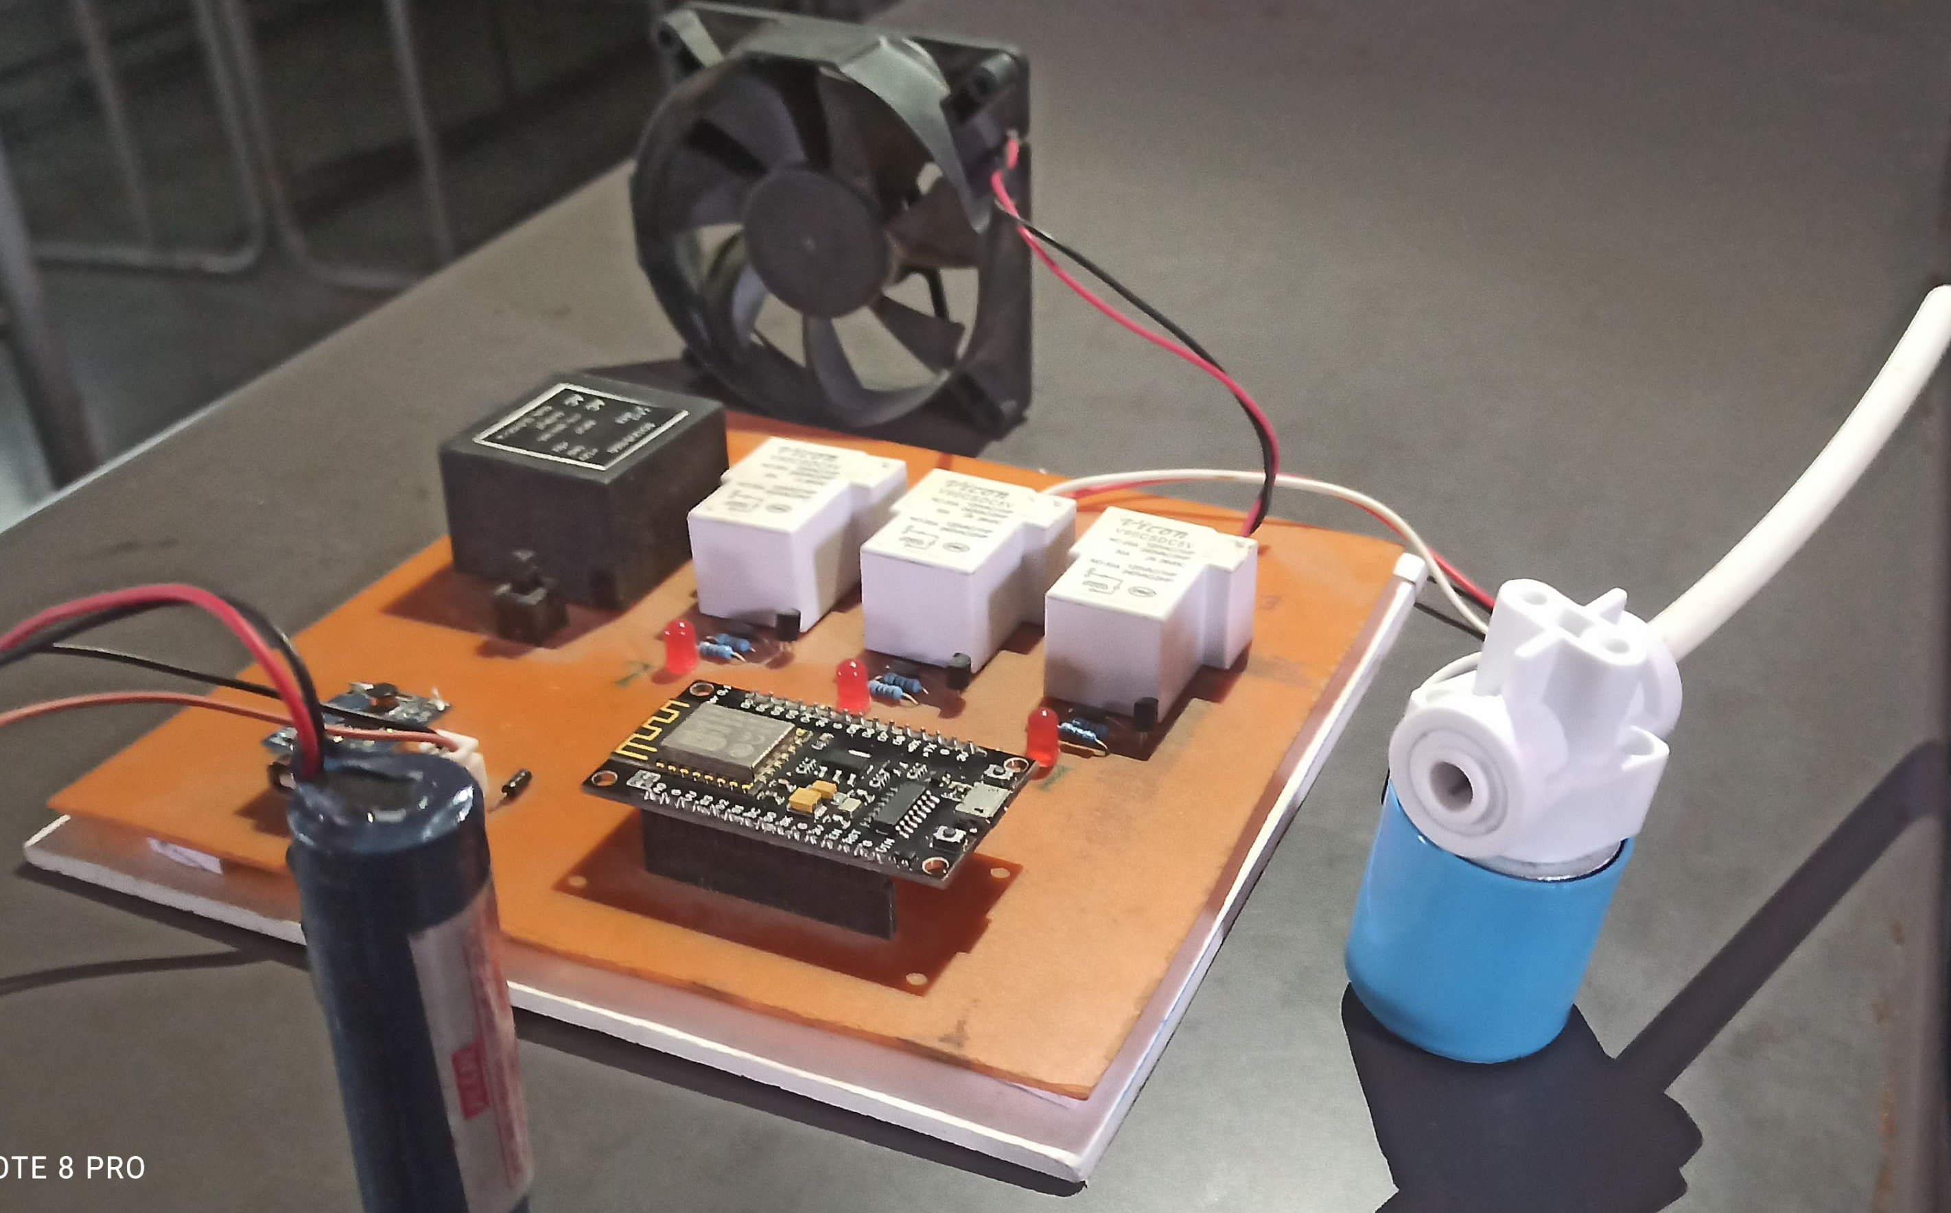
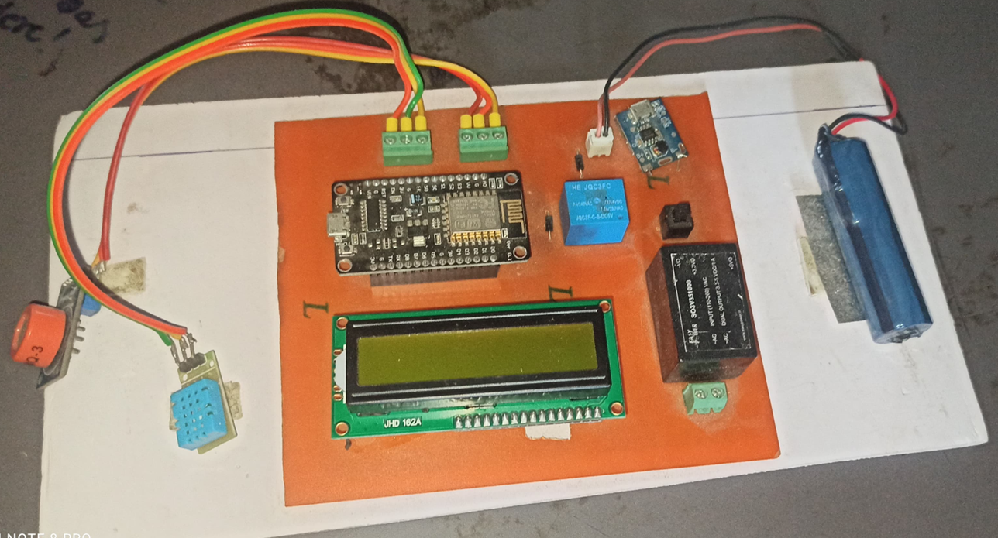
Methodology
Fig B : Integration of Monitoring Unit
Fig A : Integration of Controlling Unit

Slide 14
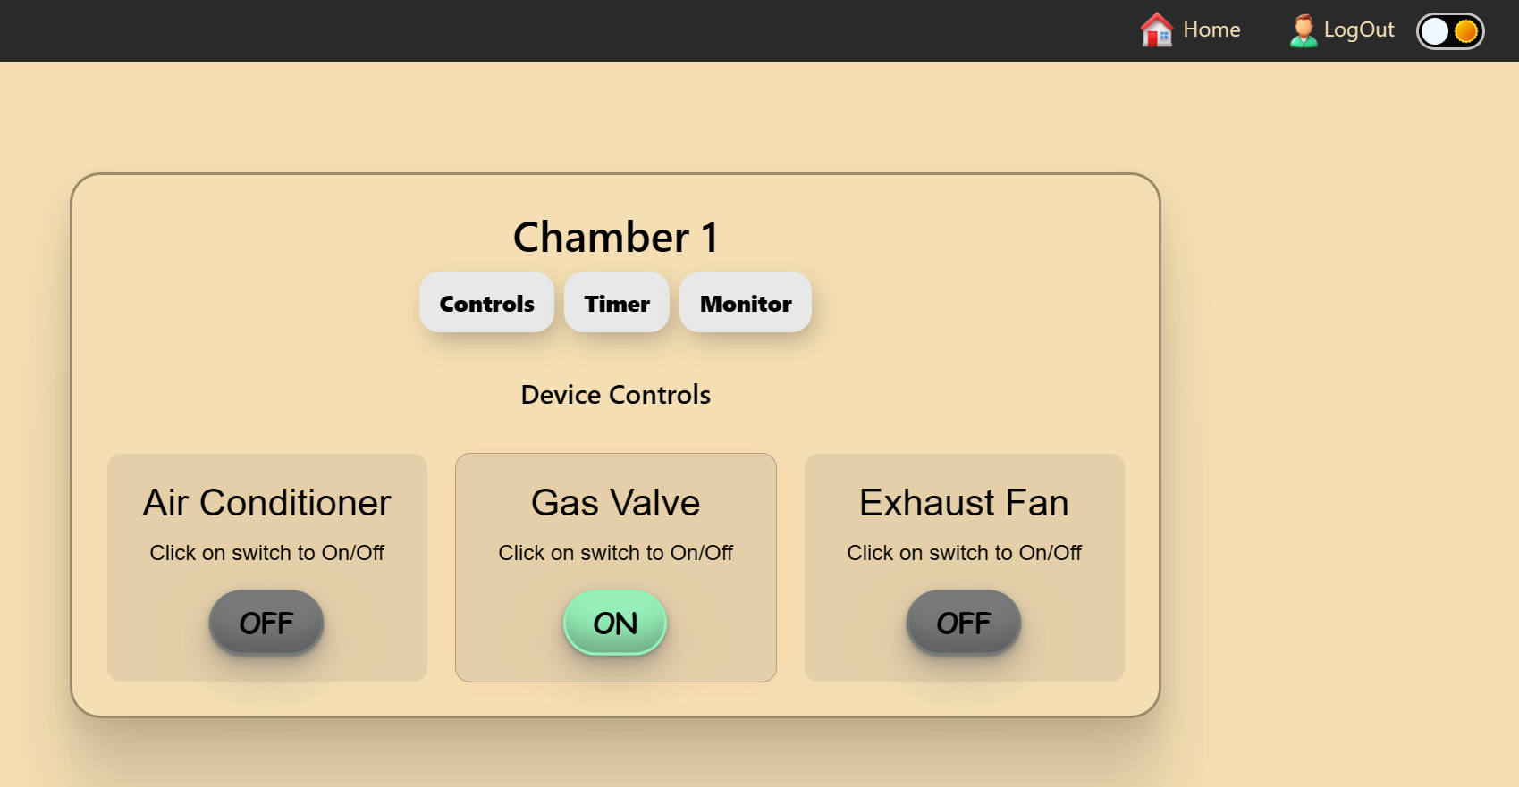
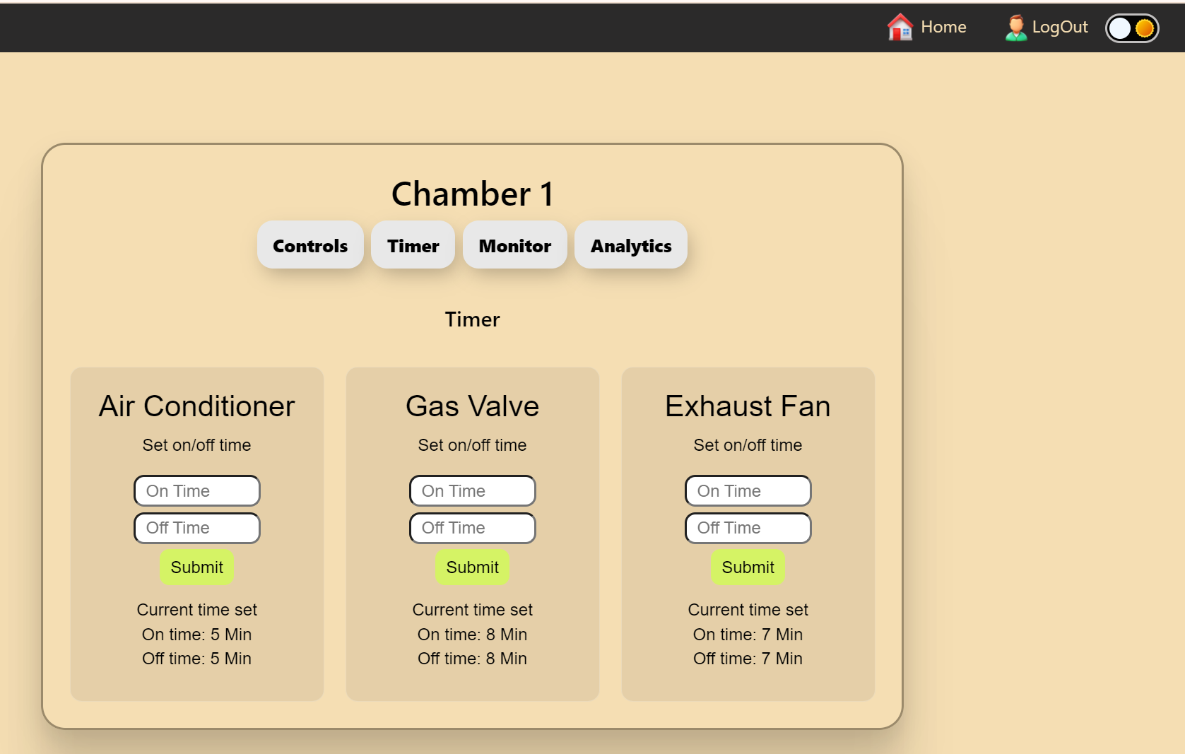
Methodology
Fig D : Web UI of Timer Control
Fig C : Web UI of Device Control

Slide 15
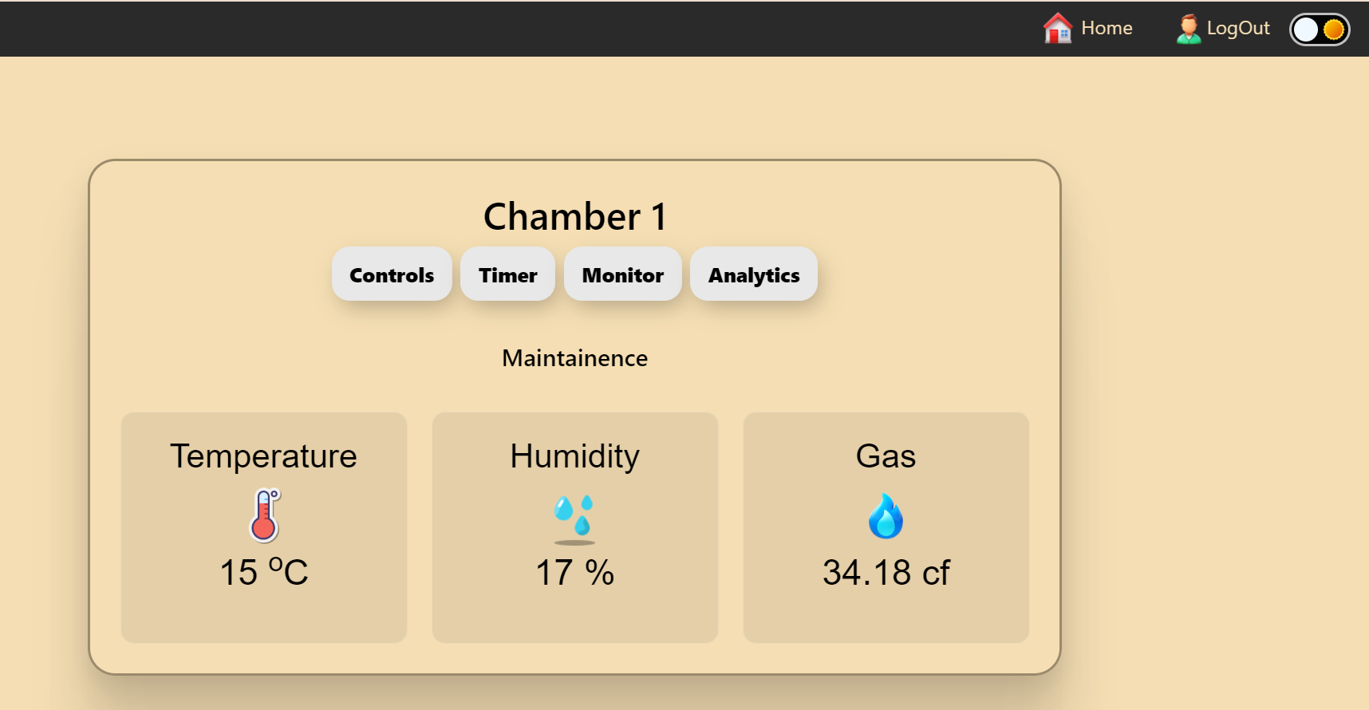
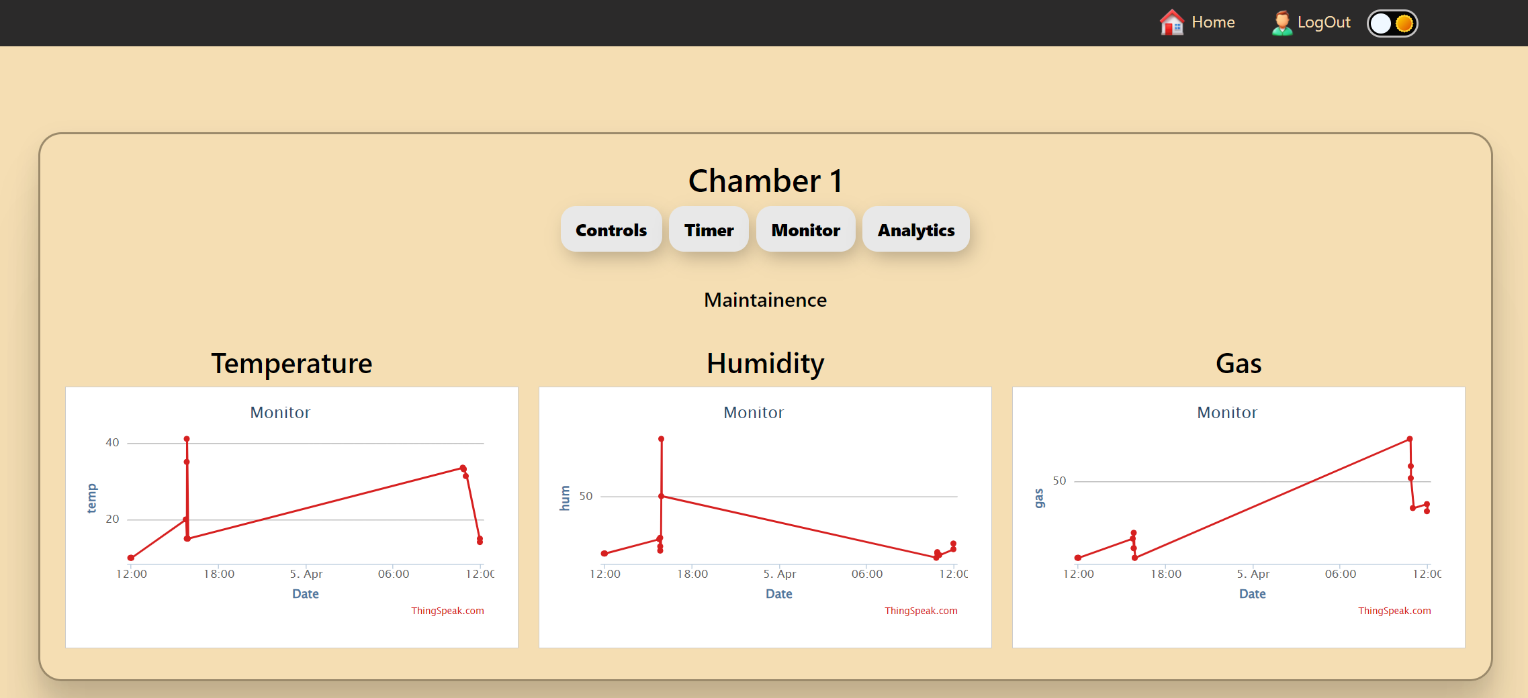
Methodology
Fig F : Web UI of Analytics
Fig E : Web UI of Maintenance

Slide 16
Results and Discussions
Integration and Efficiency:
The system successfully integrates sensors and controllers for monitoring and control.
The Master NodeMcu efficiently transmits data to the cloud server via a web-based Control Panel.
DHT11 Temperature and MQ-3 gas sensors accurately measure temperature, humidity, and gas levels in the cold storage chamber.
Critical Components:
Relay 1 operates the Air Conditioner, maintaining desired storage conditions.
Relay 2 on the master ESP controller effectively manages the Ethylene gas cylinder, preventing banana ripening during storage.

Slide 17
Results and Discussions
Efficiency and Reliability:
The IoT system addresses banana storage requirements effectively.
Seamless communication, cloud integration, and sensor accuracy contribute to a reliable solution.
Versatility and Potential:
Multiple sensors enhance the system’s capability to maintain optimal storage conditions.
Successful Ethylene gas control demonstrates practicality and potential for broader food industry applications.
Future enhancements could explore additional features and scalability.

Slide 18
Conclusion and Future Scope
In conclusion, the developed IoT based manual and automated monitoring and controlling for cold storage system has proven to be a robust and effective solution for banana storage, specifically designed to prevent ripening. The integration of Master NodeMcu, Slave controller, sensors, and relays ensures accurate monitoring and control of critical environmental parameters such as temperature, humidity, and gas levels. The successful operation of the Air Conditioner and Ethylene gas cylinder demonstrates the system's ability to maintain optimal storage conditions and prevent premature ripening of bananas.
The user-friendly web-based Control Panel and LCD display enhance accessibility and provide a convenient interface for users to monitor and manage the storage environment. Overall, the system fulfills its intended purpose of extending the shelf life of bananas by creating an ideal storage atmosphere.

Slide 19
References
1. Maged Mohammed, Khaled Riad, Nashi Alqahtani, “Design of a Smart IoT-Based Control System for Remotely Managing Cold Storage Facilities”. Sensors 2022, 22(13), 4680 (2022).
2. Yanlin T, Zuoxin Hu, Tianyu T, Xin Gao, “Effect of goods stacking mode on temperature field of cold storage”. Proceedings of EEEP 2020 IOP Conference Series: Earth and Environmental Science. Volume 675(1): 012052, 5th ICEEEP, IOP Publishing. Orlando, FL (2021).
3. Santoso Budijono, Felita, “Smart Temperature Monitoring System Using ESP32 and DS18B20”. 4th International Conference on Eco Engineering Development 2020, Banten, Indonesia. IOP Conf. Series: Earth and Environmental Science, Volume: 794 012125 (2021).
4. Hina Afreen, Imran Sarwar Bajwa, “An IoT-Based Real-Time Intelligent Monitoring and Notification System of Cold Storage”. IEEE Access PP(99): 1-1. (Volume 9), ISSN: 2169-3536, (2021).

Slide 20
THANK YOU

